Slide 1

Windsurfing Fleet Racing Rules 2021-2024
Racing Rules of Sailing
Appendix B

Slide 2


Windsurfing Fleet Racing Rules
Is is really different from ‘standard’ rules?
Most of the rules are the same as ‘standard’ rules, except some, which are stated in RRS Appendix B – Windsurfing Fleet Racing Rules;
RRS Windsurfing Fleet Racing Edition
https://www.sailing.org/tools/documents/RRS20212024
WindsurfEdition1Jan2021-[27128].pdf

Slide 3
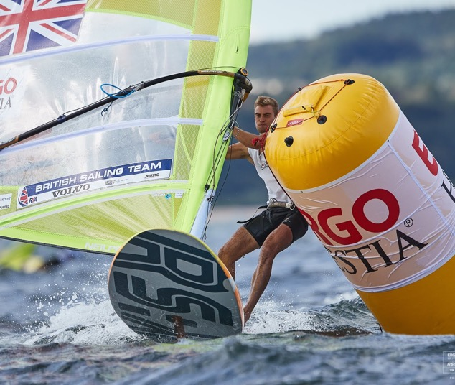
Windsurfing Fleet Racing Rules
Changes to definitions
The definition Mark-Room is deleted and replaces by;
Mark-Room
Mark-Room for a board is room to sail
her proper course to round or pass
the mark.

Slide 4
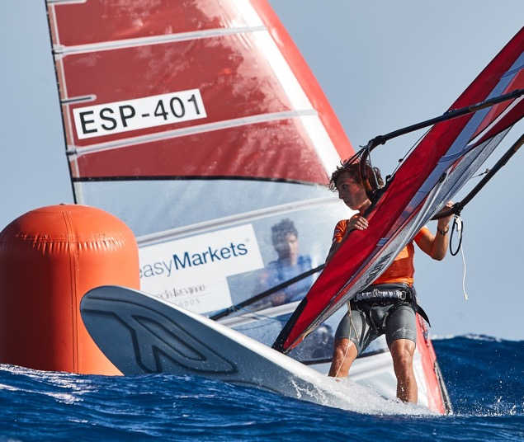
Windsurfing Fleet Racing Rules
Changes to definitions
This part of definition Mark-Room is not changed!
Mark-Room
However, mark-room for a board does
not include room to tack unless she
is overlapped inside and to windward
of the board required to give mark-room and she would be fetching the mark after her tack.

Slide 5
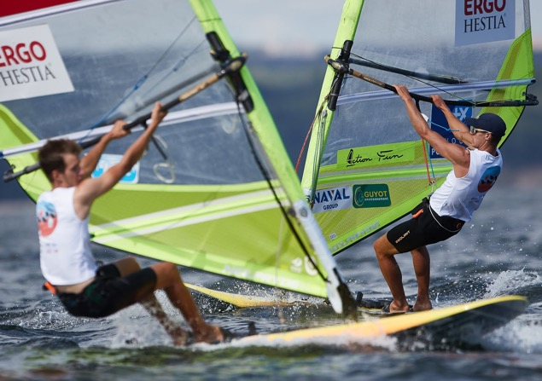
Windsurfing Fleet Racing Rules
Changes to definitions
The definition Tack, Starboard or Port is deleted and replaces by;
Tack, Starboard or Port
A board is on the tack, starboard or port, corresponding to the competitor’s hand that would be nearer the mast if the competitor were in normal sailing position with both hands on the wishbone and arms not crossed.
A board is;
on starboard tack when the competitor’s right hand would be nearer the mast and;
on the port tack when the competitor’s left hand would be nearer the mast.

Slide 6
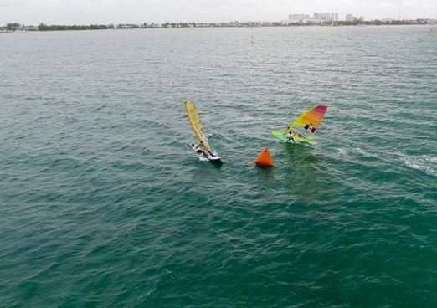
Windsurfing Fleet Racing Rules
Changes to definitions
Zone
The definition ZONE is deleted.

Slide 7
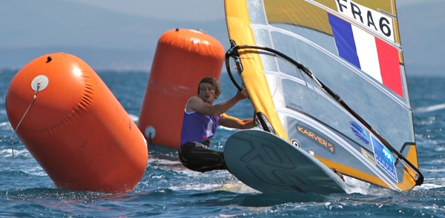
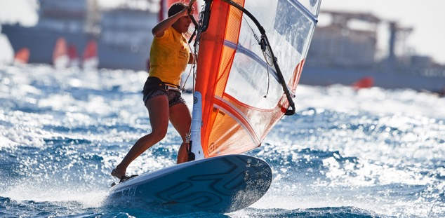
Windsurfing Fleet Racing Rules
Add new definitions
Add new definition Rounding or Passing as follows;
Rounding or Passing
A board is rounding or passing a
mark from the time her proper course
is to begin to manoeuvre to round or pass it, until the mark has been
rounded or passed.

Slide 8
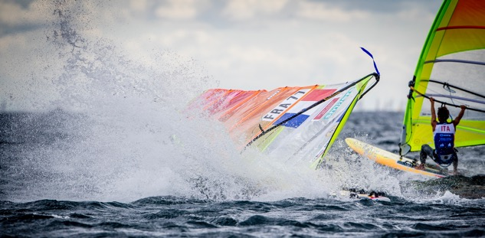

Windsurfing Fleet Racing Rules
Changes to definitions
Add new definition Capsized as follows;
Capsized
A board is capsized, when she
is not under control because;
her sail or
the competitor
is in the water.

Slide 9
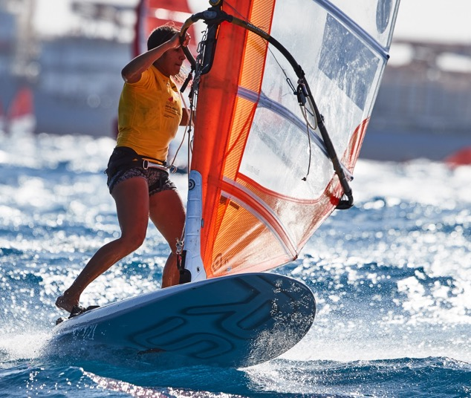
Windsurfing Fleet Racing Rules
B1 Changes to the rules of Part 1
No changes.

Slide 10
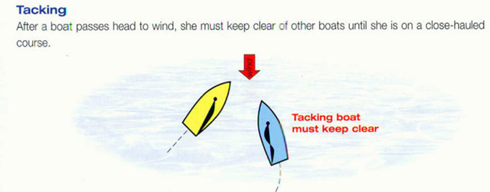
Windsurfing Fleet Racing Rules
B2 Changes to the rules of Part 2
RRS B13 While Tacking
Rule 13 changed as follows:
After a board passes head to wind,
she shall keep clear of other boards until her sail has filled.
During that time rules 10, 11 and 12 do not apply. If two boards are subject to this rule at the same time;
the one on the others port side or
the one astern shall keep clear.

Slide 11
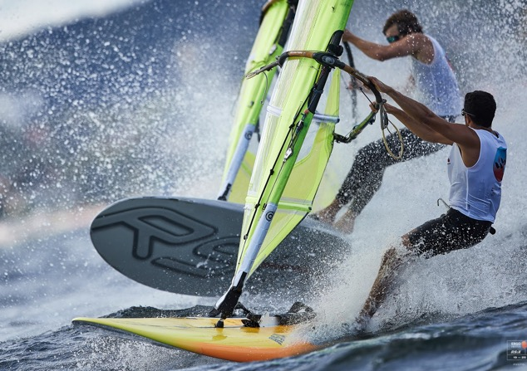
Windsurfing Fleet Racing Rules
B2 Changes to the rules of Part 2
RRS B17 On the Same Tack Before a Reaching Start
Rule 17 changed as follows
When, at the warning signal, the course
to the first mark is approximately 90 degrees from the true wind, a board overlapped to leeward of another board on the same tack during the last 30 seconds before her starting signal shall not sail above the shortest course to the first mark while they remain overlapped if as a result the other board would need to take action to avoid contact, unless in doing so she promptly sails astern of the other board.

Slide 12

Windsurfing Fleet Racing Rules
B2 Changes to the rules of Part 2
RRS B18 Mark-Room
Rule 18 is changed as follows
The first sentence of rule 18.1 is changed to;
Rule 18 applies between boards when they are required to leave a mark on the same side and at least one of them is rounding or passing it.

Slide 13

Windsurfing Fleet Racing Rules
B2 Changes to the rules of Part 2
RRS B18 Mark-Room
Rule 18.2(b) is changed as follows
If boards are overlapped when the first of them is rounding or passing the mark, the outside board at that moment shall thereafter give inside board mark-room.
If a board is clear ahead when she is rounding or passing the mark, the board clear astern at that moment shall thereafter give her mark-room.

Slide 14
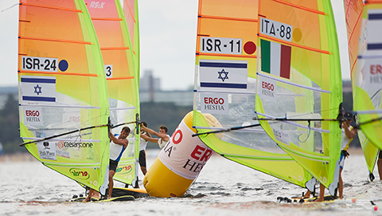
Windsurfing Fleet Racing Rules
B2 Changes to the rules of Part 2
RRS B18 Mark-Room
Rule 18.2(c) is changed as follows
When a board is required to give mark-room by rule B18.2(b), she shall continue to do so even if later an overlap is broken or a new overlap begins.

Slide 15
Windsurfing Fleet Racing Rules
B2 Changes to the rules of Part 2
RRS B18 Mark-Room
Rule 18.2(d) is changed as follows
d) Rules 18.2(b) and (c) cease to apply if the board entitled to mark-room passes head to wind.
… leaving Zone is deleted!

Slide 16

Windsurfing Fleet Racing Rules
Part 2 Rules deleted
Rule 18.3 (Tacking in the Zone) is deleted.

Slide 17
Windsurfing Fleet Racing Rules
B2 Changes to the rules of Part 2
RRS B18.4 Gybing and Bearing Away
Rule 18.4 is changed as follows
When an inside overlapped right-of-way board must gybe or bear away at the mark to sail her proper course, until she gybes or bears away she shall sail no farther from the mark than needed to sail that course.
Rule 18.4 does not apply at a gate mark.

Slide 18
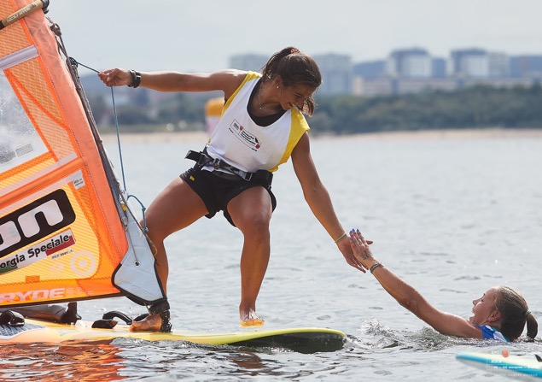
Windsurfing Fleet Racing Rules
B2 Changes to the rules of Part 2
RRS B22 Capsized; Aground; Rescuing
Rule 22 is changed to
22.1 If possible, a board shall avoid a
board that is capsized or has not
regained control after capsizing,
is aground, or is trying to help a
person or vessel in danger.
22.2 If possible, a board that is
capsized or aground shall not
interfere with another board.

Slide 19
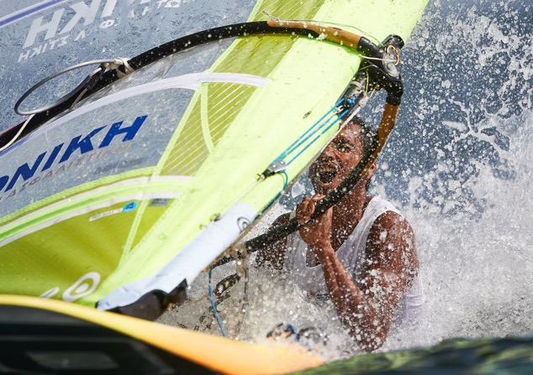
Windsurfing Fleet Racing Rules
B2 Changes to the rules of Part 2
RRS B23 Interfering with Another Board; Sail Out of Water
Add new Rule B23.3:
23.3 In the last minute before her starting signal;
  a board shall have her sail out of the water and
  in a normal position,
  except when accidentally capsized.

Slide 20




Windsurfing Fleet Racing Rules
B3 Changes to the rules of Part 3
RRS B26 Starting Races
Rule 26 is changed to:
B26.1 System 1 (for Upwind Starts)
Races shall be started by using the following signals.
Times shall be taken from the visual
signals; the absence of a sound signal shall be disregarded.
The warning signal for each succeeding class shall be made with or after the starting signal of the preceding class
Minutes before starting signal | Visual signal | Sound signal | Means
5* | Class flag | One | Warning signal
4 | P , I , U , or Black flag | One | Preparatory signal
1 | Preparatory flag removed | One long | One minute
0 | Class flag removed | One | Starting signal

Slide 21
Windsurfing Fleet Racing Rules
B3 Changes to the rules of Part 3
RRS B26 Starting Races
Rule 26 is changed to:
B26.2 System 2 (for Reaching Starts)
Races shall be started by using the following signals.
Times shall be taken from the visual signals; the absence of a sound signal shall be disregarded.
Minutes before starting signal | Visual signal | Sound signal | Means
3 | Class flag or heat number | One | Attention signal
2 | Red flag, attention signal removed | One | Warning signal
1 | Yellow flag, Red flag removed | One | Preparatory signal
1/2 | Yellow flag removed |  | 30 seconds
0 | Green flag | One | Starting signal

Slide 22
Windsurfing Fleet Racing Rules
B3 Changes to the rules of Part 3
RRS B26 Starting Races
Rule 26 is changed to:
B3.26.3 System 3 (for Beach Starts)
When the starting line is on the beach, or so close to the beach that the competitor must stand in the water to start, the start is a beach start.
The starting stations shall be numbered so that station 1 is the most windward one. Unless the sailing instructions specify some
other system, a board’s starting station shall be determined
  by ranking (the highest ranked board on station 1, the next highest on station 2, and so on), or
  by draw.

Slide 23
Windsurfing Fleet Racing Rules
B3 Changes to the rules of Part 3
RRS B26 Starting Races
Rule 26 is changed to:
B3.26.3 System 3 (for Beach Starts)
After boards have been called
to take their positions, the race committee shall make the preparatory signal by displaying
a red flag with one sound. The starting signal shall be made,
at any time after the preparatory signal, by removing the red flag with one sound.
After the starting signal each board shall take the shortest route from her starting station to the water and then to her sailing position without interfering with other boards. Part 2 rules will apply when both of the competitor’s feet are on the board.

Slide 24

Windsurfing Fleet Racing Rules
Part 3 Rules deleted
Rule 30.2 (Z Flag Rule) is deleted.

Slide 25
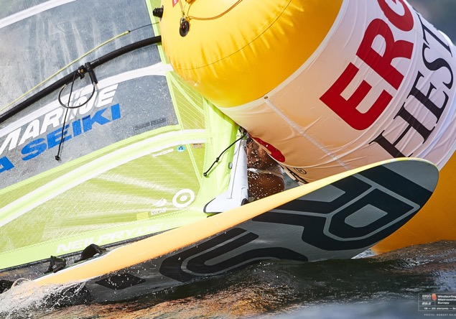
Windsurfing Fleet Racing Rules
B3 Changes to the rules of Part 3
RRS B31 Touching a Mark
Rule 31 is changed as follows
A board my touch a mark but shall not hold on to it.

Slide 26

Windsurfing Fleet Racing Rules
B4 Changes to the rules of Part 4
RRS B42 Propulsion
Rule 42 is changed as follows;
A board shall be propelled only;
by the action of the wind on
the sail, and
by the action of the water on
the hull.
However, pumping and fanning the sail is permitted.
The board shall not be propelled by paddling, swimming or walking.

Slide 27
Windsurfing Fleet Racing Rules
B4 Changes to the rules of Part 4
RRS B44 Penalties at the Time of an Incident
Rule 44 is changed to:
B44.1 Taking a Penalty
A board may take a 360°-Turn Penalty when she may have broken one of more rules of Part 2 in an incident while racing. The sailing instructions may specify the use of some other penalty. However, if the board caused injury or serious damage or, despite taking a penalty, gained a significant advantage in the race or series by her breach, her penalty shall be to retire.
B44.2 360°-Turn Penalty
After getting well clear of other boards as soon after the incident as possible, a board takes a 360-Turn Penalty by promptly making a 360° turn with no requirement for a tack or a gybe. When a board takes the penalty at or near the finishing line, her hull shall be completely on the course side of the line before she finishes.

Slide 28
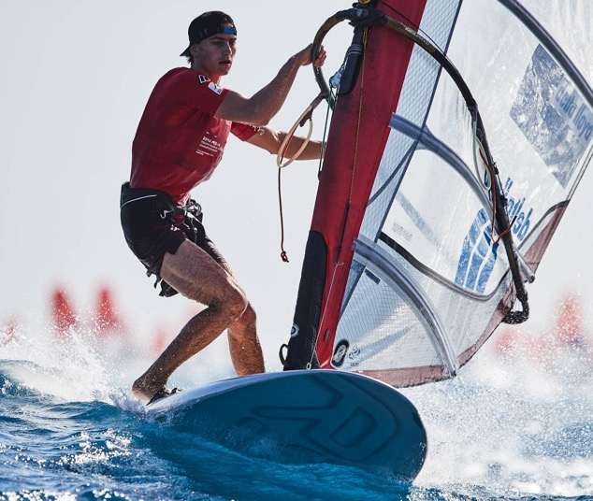
Windsurfing Fleet Racing Rules
Part 4 Rules deleted
Rules 45, 48.2, 49, 50.1(c), 50.2, 51, 52, 54, 55 and 56.1 are deleted.

Slide 29
Windsurfing Fleet Racing Rules
B5 Changes to the rules of Part 5
RRS B60 Right to Protest; Right to Request Redress
or Rule 69 Action
Rule 60.1(a) is changed by deleting “OR SAW”
Rule 60.1(a) becomes (without “saw”);
Rule 60.1(a) A board may protest another board, but not for alleged breach of a rule of Part 2 or rule
31 unless she was involved in
the incident.
Which means;
She may protest another board, if she was involved in the incident for a breach of a rule of Part 2 or rule 31.

Slide 30
Windsurfing Fleet Racing Rules
B5 Changes to the rules of Part 5
RRS B61 Protest Requirements
The rule 61.1(a) is changed to:
The protesting board shall inform the other board at the first reasonable opportunity.
When her protest will concern an incident in the racing area, she shall hail “Protest” at the first reasonable opportunity.
She shall also inform the race committee of her intention to protest as soon as practicable after she finishes or retires. However.
…
no red flag need be displayed
…
…

Slide 31
Windsurfing Fleet Racing Rules
B5 Changes to the rules of Part 5
RRS B61.2 Protest Contents
Add to rule 61.2:
This rule does not apply to a race in an elimination series that will qualify a board to compete in a later stage of an event.

Slide 32
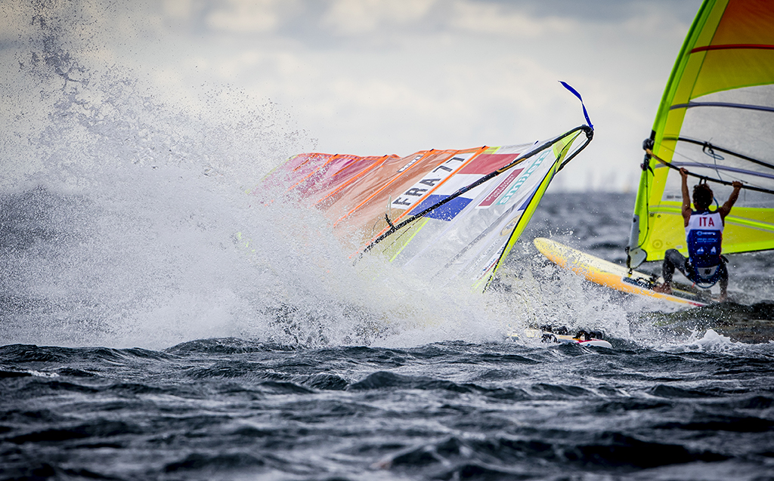
Windsurfing Fleet Racing Rules
B5 Changes to the rules of Part 5
RRS B62 Redress
Rule 62.1(b) is changed to:
injury, physical damage or capsize because of the action of
  a board that broke a rule of Part 2 and took the appropriate penalty or was penalized, or
  a vessel not racing that was required to keep clear.

Slide 33
Windsurfing Fleet Racing Rules
B5 Changes to the rules of Part 5
RRS B63 Hearings
Add to Rule 63.6:
However, for an elimination series race that will qualify a board to compete in a later stage of an event, protests and requests for redress need not be in writing;
They shall be made orally to a member of protest committee as soon as reasonably possible following the race.
The protest committee may take evidence in any way it considers appropriate and may communicate its decision orally.

Slide 34
Windsurfing Fleet Racing Rules
B5 Changes to the rules of Part 5
RRS B64 Decisions
Rule 64.4(b) is changed to:
(b) When the protest committee is in doubt about a matter concerning the measurement of a board, the meaning of a class rule, or damage to a board, it shall refer its questions, together with the relevant facts, to an authority responsible for interpreting the rule. In making its decision, the committee shall be bound by the reply of the authority.

Slide 35
Windsurfing Fleet Racing Rules
B5 Changes to the rules of Part 5
RRS B65 Informing the Parties and Others
Add to Rule 65.2:
This rule does not apply to a race in an elimination series that will qualify a board to compete in a later stage of an event

Slide 36
Windsurfing Fleet Racing Rules
B5 Changes to the rules of Part 5
RRS B70 Appeals and Re quests to a National Authority
Rules 70.5 and 70.5(a) are changed to:
There shall be no appeal from the decisions of an international jury constituted in compliance with Appendix N, and no appeal from the decision of the protest committee for a race in an elimination series that will qualify a board to compete in a later stage of an event.
Furthermore, if a Notice of Race or Sailing Instructions so state, the right of appeal may be denied provided that
(a) It is essential to determine promptly the result of a race that will qualify a board to compete in a subsequent event (a National Authority may prescribe that its permission is required for such a procedure);

Slide 37
Windsurfing Fleet Racing Rules
B6 Changes to the rules of Part 6
RRS B78 Compliance with Class rules; Certificates
Add to rule 78.1:
When so prescribed by World Sailing, a numbered and dated device on a board and her centreboard, fin and rig shall serve as her measurement certificate.

Slide 38
Windsurfing Fleet Racing Rules
B7 Changes to the rules of Part 7
RRS B90 Race Committee; Sailing Instructions; Scoring
The last sentence of rule 90.2(c) is changed to:
Oral instructions may be given only if the procedure is stated in the sailing instructions.

Slide 39
Windsurfing Fleet Racing Rules
B8 Changes to Appendix A
RRS B8 A1 Number of Races; Overall Scores
Rule A1 is changed to:
The number of races scheduled
and the number required to be completed to constitute a series
shall be stated in the Notice of
Race or Sailing Instructions.
If an event includes more than one discipline or format, the Notice of Race or Sailing Instructions shall state how the overall scores are to be calculated.

Slide 40
Windsurfing Fleet Racing Rules
B8 Changes to Appendix A
RRS B8 A2.1 Series Scores
Rule A2.1 is changed to:
Each board’s series score shall, subject to rule 90.3(b), be the total
of her race scores excluding her
worst score when from 5 to 11 races have been completed, or
two worst scores when
12 or more races have
been completed.
However, the Notice of Race or Sailing Instructions may make a different arrangement. A race is completed if scored; see rule 90.3(a).)
If a board has two or more equal worst scores, the score(s) for the race(s) sailed earliest in the series shall be excluded.
The board with the lowest series score wins and others shall be ranked accordingly.

Slide 41
Windsurfing Fleet Racing Rules
B8 Changes to Appendix A
RRS B8 A8 Series Ties
Rule A8 is changed to:
A8.1 If there is a series-score tie between two or more boards, each board’s excluded race scores shall be listed in order of best to worst, and at the first point(s) where there is a difference the tie shall be broken in favor of the board(s) with the best excluded race score(s).
A8.2 If a tie remains between two or more boards, each board’s race scores, including excluded scores, shall be listed in order of best to worst, and at the first point(s) where there is a difference the tie shall be broken in favour of the board(s) with the best score(s). These scores shall be used even if some of them are excluded scores.

Slide 42
Windsurfing Fleet Racing Rules
B8 Changes to Appendix A
RRS B8 A8 Series Ties
Rule A8 is changed to:
A8.3 If a tie still remains between two or more boards, they shall be ranked in order of their scores in the last race.
Any remaining ties shall be broken by using the tied boards’ scores in the next-to-last race and so on until all ties are broken.
These scores shall be used even if some of them are excluded scores.

Slide 43

Any questions?

Slide 44


